Slide 1

PE & SPORT PREMIUM REPORTING TOOL
Tuesday 24th June

Slide 2
Aims of the session
Support with the login process for the new reporting tool
Familiarise yourselves with the content, layout and requirements of the new reporting tool
Offer guidance on terminology, appropriate spend and FAQs
Increase confidence in using the new reporting tool
Familiarise new PE Leads with the aims, parameters and intended outcomes of the funding
Answer questions

Slide 3
To Get Started
All primary schools need to complete the digital expenditure reporting return for the PE and Sport Premium, for the 2024 to 2025 academic year, by 5pm on Thursday 31 July 2025.
Before you start you need a DfE sign in account that links to your school, if you don’t have one then you need to create an account.
Ensure your account is set up linked to a real staff member – email addresses like PE@ have flagged up some issues
ACCESS THE FORM THROUGH THE ‘ONLINE FORM’ LINK – POINT 1 UNDERNEATH THE ”ACCESS THE FORM THROUGH DfE SIGN-IN” HEADER WITHIN GUIDANCE DOC
https://www.gov.uk/guidance/complete-the-pe-and-sport-premium-expenditure-reporting-return
Reporting form access
DfE Sign-in account
create an account

Slide 4
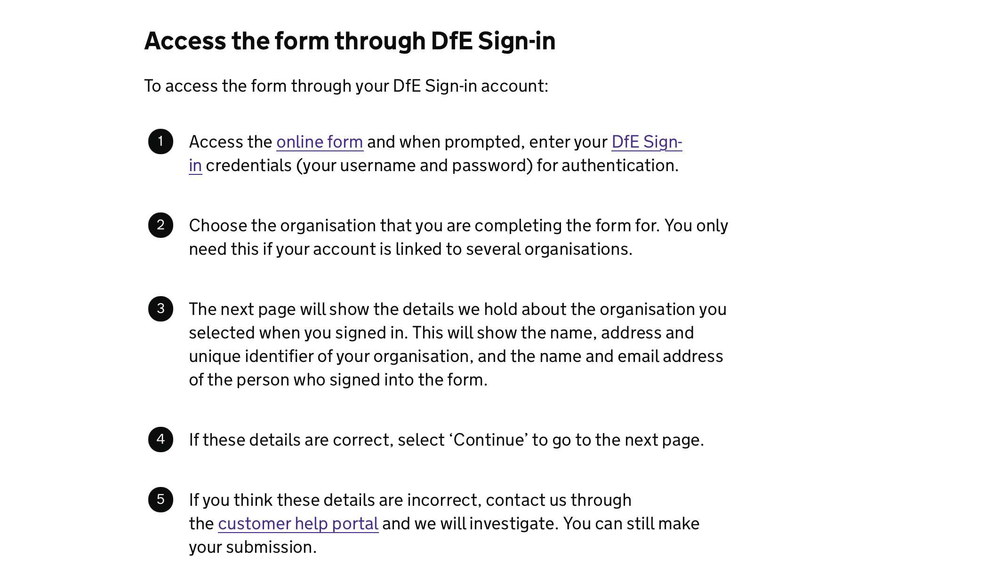
Use this link

Slide 5
To Get Started
If you do not have a DfE Sign-in account
If you do not have a DfE Sign-in account, you need to create one.
Access DfE Sign-in page and select ‘create a DfE Sign-in account’. On the next page, select ‘No account? Create one’. Then follow the instructions.
You might notice the term ‘approver’ when you create your account. An approver is someone at your organisation responsible for controlling who has access to DfE Sign-in and the services within the system. It is usually a senior person, such as an administrator or a Headteacher.
You need the approval of one of your organisation’s approvers before you can access the form.
Add an organisation to your DfE Sign-in account
You may need to add a new organisation to your DfE Sign-in account to access the forms.
To do this, select ‘organisations’, then ‘request access to an organisation’ from the related actions. Then follow the instructions.
Multiple staff within the same school can work on the document

Slide 6
Planning & Prep
Before you Start
Make sure you have within you:
The total amount of funding allocation received this academic year (check with Business Manager if unsure) – based on January 2024 census data
A breakdown of how your school has spent its PE and sport premium funding this academic year (AfPE document or similar, SAP/VT Balance sheet etc)
Knowledge of your schools ‘de-minis’ value – the value at which a purchase becomes classed as an asset on schools balance sheet
Understanding of whether your school has prioritised any funding to support disadvantaged children, girls, or children with special educational needs and disabilities (SEND) or long-term medical conditions
Knowledge of the impact on pupils’ PE attainment, physical activity and sport participation through your use of PE and sport premium funding
Show how you have used your PE and sport premium funding to make sustainable improvements

Slide 7
Swimming Data
You will be asked if your school had Y6 pupils, if you do you will need to enter the percentage of pupils in year 6 who have met the national curriculum requirement to:
  Swim competently, confidently and proficiently over a distance of at least 25 metres
  Use a range of strokes effectively – for example, front crawl, backstroke and breaststroke
  Perform safe self-rescue in different water-based situations
  Ensure you have knowledge of additional funding spend for ‘top-up’ swimming sessions
  Remember this data is referring to your current Y6 cohort – regardless of when they completed swimming as part of the National Curriculum

Slide 8
The Form
The first page is ‘your details’ This will show:
the name of the school associated with the DfE Sign-in account
the school’s allocation for the 2024 to 2025 academic year
There are then 4 sub-forms, they are:
form 1: your school’s PE and sport premium funding allocation for the 2024 to 2025 academic year
form 2: details of how the PE and sport premium funding has been spent for the 2024 to 2025 academic year
form 3: the outcomes of spending the PE and sport premium – opportunities, impacts, sustainability details, and meeting swimming and water safety requirements
form 4: final declaration
Complete and submit all the sub-forms for the 2024 to 2025 academic year. You can complete them in the order you find convenient.
Selecting ‘save and continue’ on each page will take you through the forms.

Slide 9
Form 1: Your Schools Funding Allocation
The amount of PE and sport premium funding received by your school for the 2024 to 2025 academic year will be pre-populated.
You need to confirm the amount of any:
unspent funding for academic year 2024 to 2025
funding you have carried forward from the previous academic years
The PE and sport premium guidance has more information on this. We need information regarding carry forward and unspent funding to support future policy thinking.
You can only enter positive numeric values. If the answer is none, enter zero (0).

Slide 10
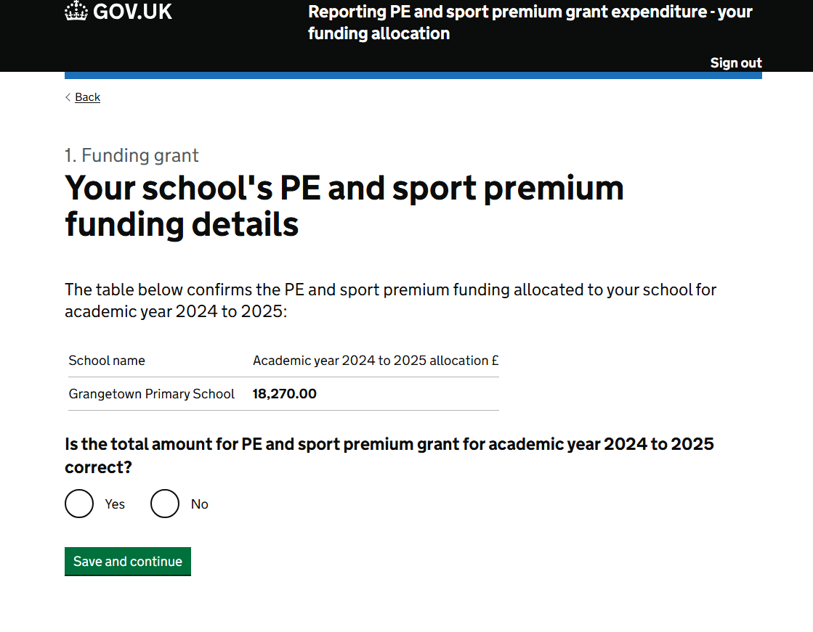

Slide 11
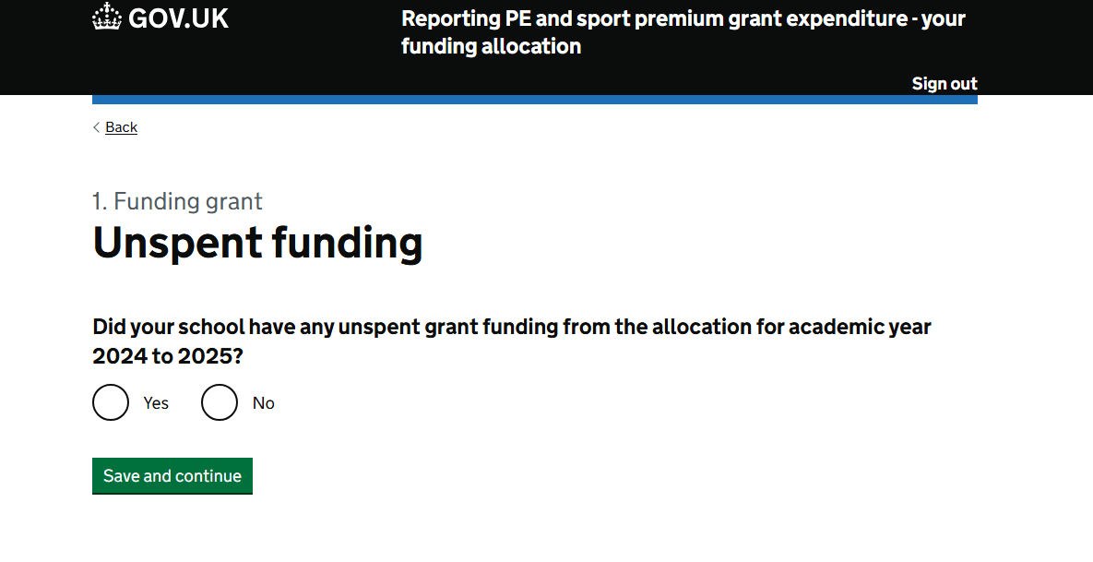

Slide 12
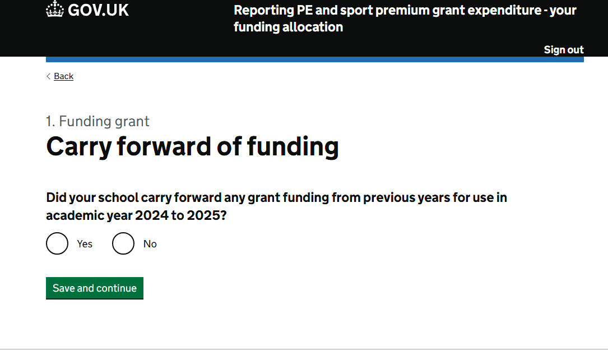

Slide 13
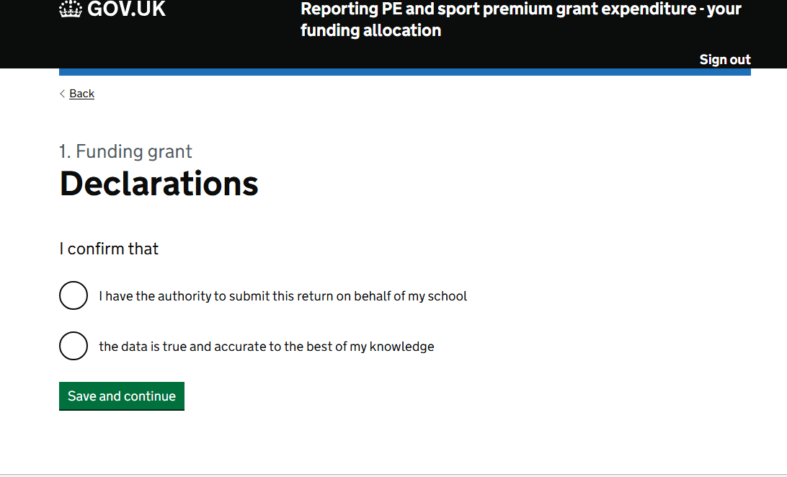

Slide 14
Form 2: How you have spent the PE & Sport Premium Funding
Give a full breakdown of how your school has spent its PE and sport premium funding. We have broken it down across a series of categories.
This sub-form asks for a monetary category breakdown across continued professional development, internal and external activities spent by your school in academic year 2024 to 2025.
If your school has spent money on a certain category, select the appropriate tick box for that category from the list provided. You can select as many categories as are relevant.
You will then be taken to an individual page for each category you selected, where you can enter the value of the spend in the appropriate box.
You can only enter positive numeric values. If the answer is none, enter zero (0).

Slide 15
Form 3: The outcomes of spending the PE & Sport Premium
The PE and sport premium should be used to support all pupils in your school, but you may also target some of your spending on certain pupils.
In this section you should show if you have done that.
These findings will allow us to make sure our PE and sport premium guidance is as helpful as possible.
This section will ask if your school has prioritised any funding to provide or improve sport opportunities for:
children with SEND, including children with long-term medical conditions
girls
disadvantaged pupils
Perceived impacts and improvements in PE and sport
In this section you need to consider the perceived impact that PE and sport premium funding has had on pupils’ PE attainment, physical activity and sport participation in academic year 2024 to 2025.
This will include questions about the 5 key areas for improvement where you should prioritise funding. Select from the 4 options which best describe the impact you think PE and sport premium funding has had in your school. (remember you don’t have to hit all 5 key areas)

Slide 16
Form 3: The outcomes of spending the PE & Sport Premium
Achieving sustainable outcomes
In this section you need to describe how your school will make sure the improvements you have made from spending the PE and sport premium:
are sustainable
will benefit pupils joining in future years
Describe how you:
have built capacity and capability for your school
will make sure these improvements will be sustainable
Meeting requirements for swimming and water safety
In this section, provide data on the percentage of pupils in your year 6 cohort in the current academic year who met the national curriculum swimming and water safety requirements.
Use attainment data from year 6 pupils’ most recent swimming and water safety lessons.
This may be data from previous years, depending on the swimming and water safety programme at the school. If this does not apply to your school, select no and you will move to the next section.
Enter your answers as a percentage. Your answer must be a number between zero (0) and 100.

Slide 17
Form 4: Declarations
Submission summary
The summary page allows you to check your answers before submitting each sub-form.
You can change your answers using the ‘Change’ link that appears next to each data entry.
At the end of each sub-form, you will be asked to complete a short declaration to allow submission.
Following submission, you will receive an email confirmation of your submission that will include a link to download a PDF copy of your submitted return. Schools are permitted to use the downloaded PDF report to upload onto their website to meet reporting requirements.
We recommend you download and save a copy of your submitted returns as soon as possible, as access to the form will only be available for 6 months from submission.
Declarations
Once all forms have been completed the declaration form will be accessible for you to complete your final confirmations.
Prior to submission, sign off for the digital expenditure reporting return is required from your Headteacher and Chair of Governors.
Once you have completed your submission, you must agree to the mandatory declarations.
To do this, you will need to tick each statement box to confirm your agreement.
You will not be able to submit your completed return without fully completing this page.

Slide 18
DfE Top Tips
Before completing
Ensure you have your DfE sign in account active and that any others who will need to authorise the report also have access. GIVE YOURSELF PLENTY OF TIME – START THIS PROCESS ASAP
Ensure you have details of your funding breakdown, PE Funding Evaluation report (AfPE) and a notepad to make any notes.
Read through the guidance and consider what you need for each section before completing.
Completing the form
Consider all impacts the funding has had and if it wasn’t in place how would that change the school’s approach.
Be aware some sections ask for responses again so save a copy of your answers to simplify submission.
Ensure you include a thorough breakdown of your spend
Ensure you have your top-up swimming spend as well as your continual professional development, membership subscriptions and extracurricular support spending.
Use the useful summary section to ensure all inputs are accurate and correct.
You do not need to put an amount against each area, just the areas where you have spent funding.

Slide 19
DfE Advice
Perceived impacts
Aim to be positive with all impact questions - be proud of your achievements and the impact you have had within the school through the academic year.
Impact section is simple and wants to hear your perspective in your school so is broken down into three areas 1. Opportunities 2. Perceived impact 3. Sustainability
Submitting evidence and following submission
Use the option to download PDF versions and complete the report in small segments.
Celebrate these achievements within your school. This is a team effort so do bring in senior colleagues to check and assure you are content with submission.
Use the PDF option to download the completed reports and then submit this along with the PE Funding Evaluation form as your completed report.
Remember you still need to upload a report onto your school website by 31st July 2025 – this can be downloaded directly from the reporting tool

Slide 20
FAQs & Terminology
You are still required to upload a report on your funding spend on your school website by 31st July – this can be downloaded from the portal
Remember, the swimming data entered applies to your CURRENT Y6 cohort – even if they haven’t gone swimming since Y4 - you’re expected to still have the data
Internal vs External – in this context Internal CPD delivered by your school staff (lesson observations etc). External is delivered by organisations like AVSSP regardless of the location of the training
Internal competitions will cover inter-class or inter-house as well as enrichment activities like Tough Runner etc
De-minis value – varies on school/MAT/LA – Business Manager should know the figure

Slide 21
Funding allocations
PE Specialist delivery – CPD section – External coaches supporting confidence and competence
Affiliation – Internal spend section - Internal memberships
On-site CPD – CPD section - External training courses
Equipment – Internal equipment & resources
Transport – External spend section – Competitions & Events

Slide 22
Future of the PE & School Sport Network
Last week, the Prime Minister announced plans for a new approach to PE and school sport including new School Sports Partnerships and a new Enrichment Framework for schools, to ensure all young people have equal access to high-quality sport and extracurricular activity.
The Government announced the creation of a new national network, which will:
Build strong partnerships between schools, local clubs and National Governing Bodies.
Focus on identifying and breaking down barriers to sport for children who are less active, primarily girls, and pupils with special educational needs and disabilities.
Ensure inclusive best practice is shared and adopted widely across all schools in England.
Be supported by a new Enrichment Framework to ensure all young people have equal access to high-quality extra-curricular activities.
Be linked to new school profiles, which will publish information about every school’s sport and enrichment offer.

